Slide 1
Sql server database BELLA PUSPIETA M Hudya Ramadhana m insan hamzah
CCIT – FACULTY OF ENGINEERING UNIVERSITY OF INDONESIA

Slide 2
Background of SQL SERVER

Slide 3
Briefly Description of Database

Slide 4
Definition of SQL Server

Slide 5
Function of SQL Server

Slide 6
History of SQL Server
1988
1990
1993
1994
1995
1996
1997
1998
2000
2005
2008
2012
2014

Slide 7
Feature of SQL Server
Relational Database Engine
Notification Services
Reporting Services
Service Broker
SQL Server Agent
Replication
Full Text Search
XML Support
Multi-Instance Support
DTS Enhancement

Slide 8
How to Install SQL Server

Slide 9
1. Choose the Bit on your computer

Slide 10
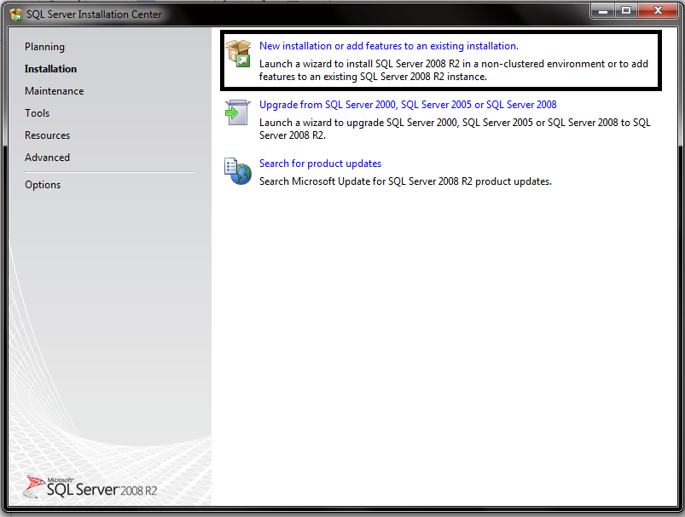
2. Choose New Installation if you never install SQL Server

Slide 11
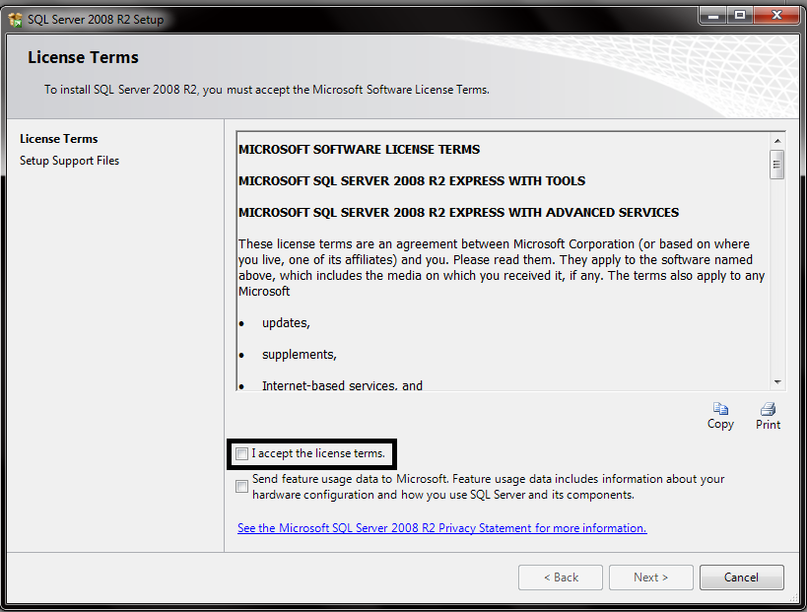
3. Click Accept Terms.

Slide 12
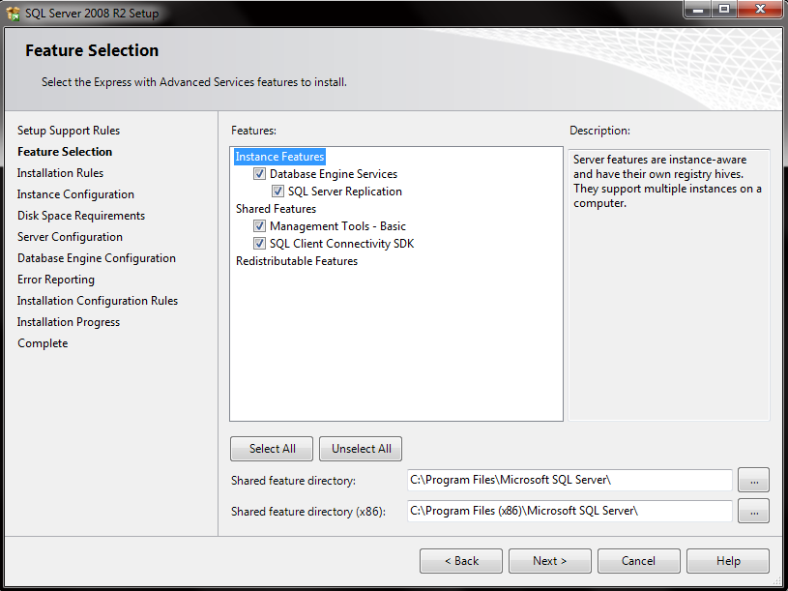
4. Select All Features , choose the feature directory place on your computer and Click next.

Slide 13
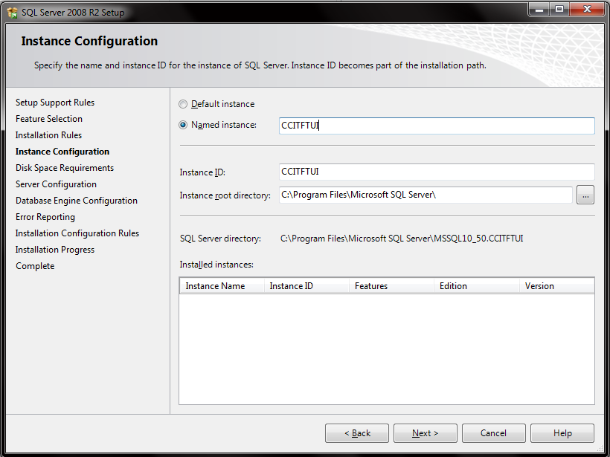
5. Write your instance name and instance ID, instance ID will be your ID at your directory file. You can’t put special character for your instance.

Slide 14
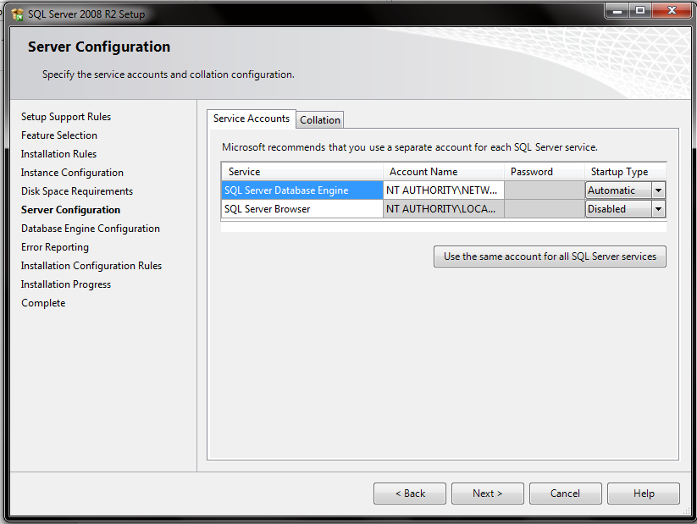
6. This is Service Account step, make sure you use separate account like Microsoft recommends. If you done, click next.

Slide 15
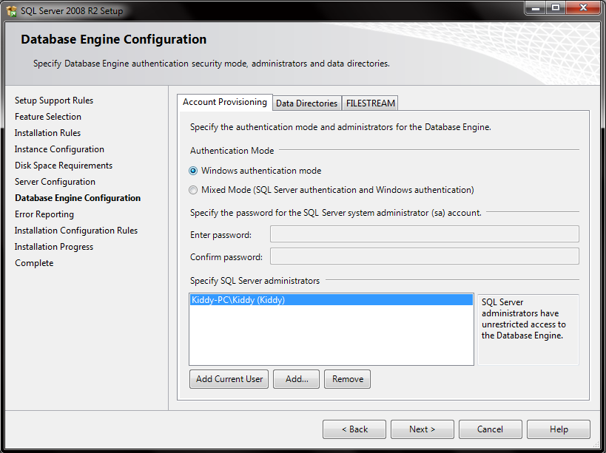
7. In this section you will choose the password for your database. In this section you can choose the user who can use this Database Application.

Slide 16
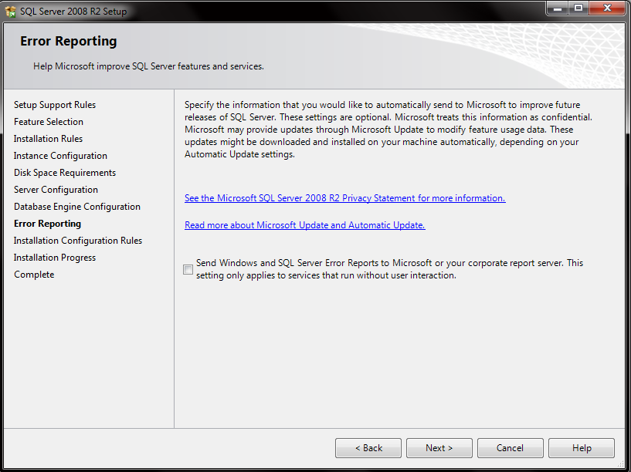
8. You can choose Send Windows Error Report to Microsoft or your Corporate Report Server if something happened to your Database.

Slide 17
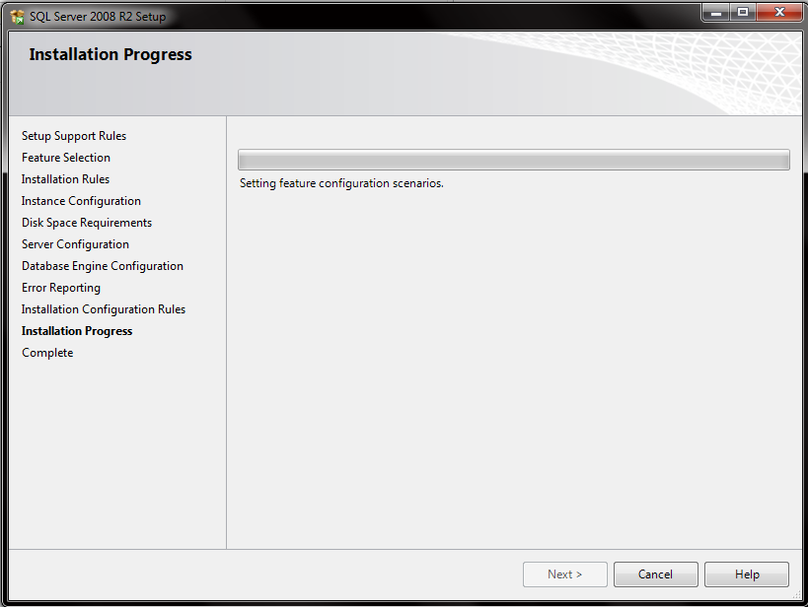
9. Please wait untill installation progress completed.

Slide 18
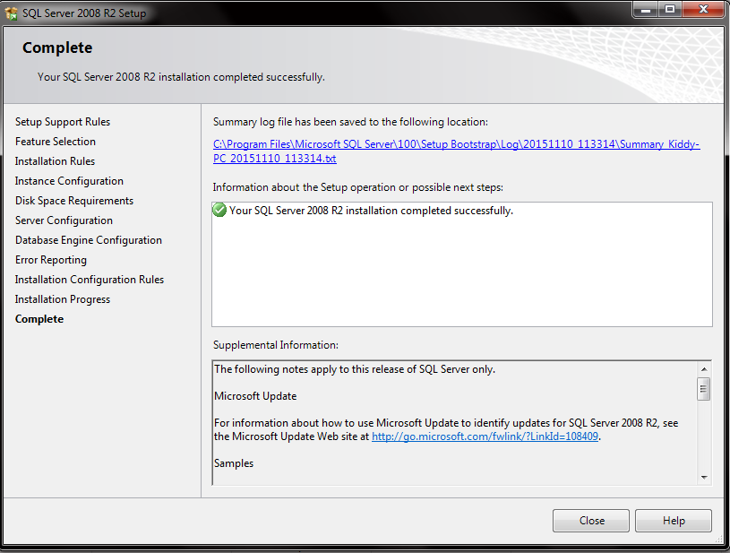
10. Click close when the installation was completed.

Slide 19
Advantages and Disadvantages

Slide 20
Comparison Between SQL Server and MySQL

Slide 21
Suggestion
Choose Database Applications in accordance with company requirements.
Choose the appropriate Database Applications with the ability of the company.
Create a database that is good and right in order to avoid things that are not desirable.

